Slide 1
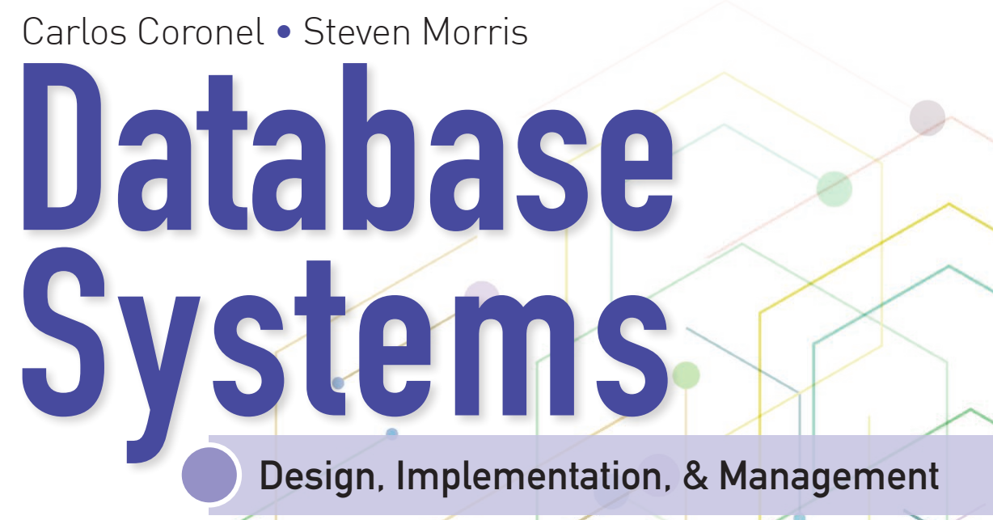
Database Systems: Design, Implementation, and Management 14th Edition
Chapter 1
Database Systems

Slide 2


National Economics University Faculty of Data Science & Artificial Intelligence
Database System Design, Implementation And Management Course – Data Model
Instructor: Duc Minh Vu (FDA – SLSCM Lab)
Email: minhvd [at] neu.edu.vn
12/19/2024
Database System Design, Implementation And Management
2

Slide 3
Learning Objectives
Discuss data modeling and why data models are important
Describe the basic data-modeling building blocks
Define what business rules are and how they influence database design
Outline how the major data models evolved
List emerging alternative data models and the needs they fulfill
Explain how data models can be classified by their level of abstraction

Slide 4
Introduction
Designers, programmers, and end users see data in different ways
Different views of same data lead to designs that do not reflect organization’s operation
Data modeling reduces complexities of database design
Various degrees of data abstraction help reconcile varying views of same data

Slide 5
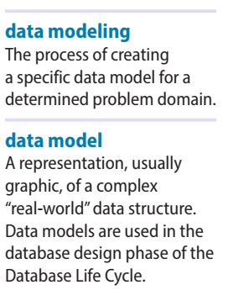
2-1 Data Modeling and Data Models
Data models
Relatively simple representations of complex real-world data structures
Often graphical
Model: an abstraction of a real-world object or event
Useful in understanding complexities of the real-world environment
Data modeling is iterative and progressive

Slide 6
2-2 The Importance of Data Models
Facilitate interaction among the designer, the applications programmer, and the end user
End users have different views and needs for data
Data model organizes data for various users
Data model is an abstraction
Cannot draw required data out of the data model

Slide 7
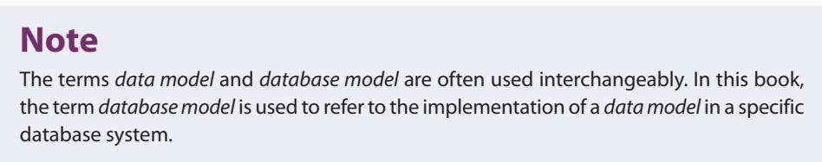
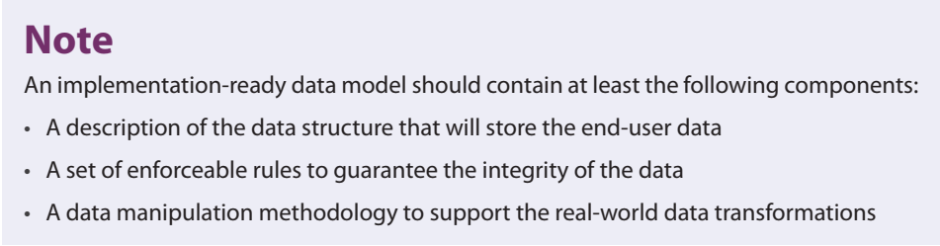

Slide 8
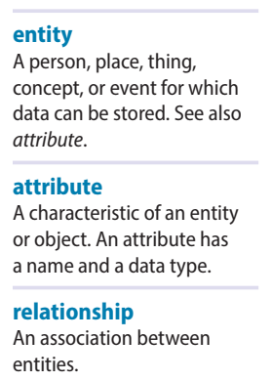
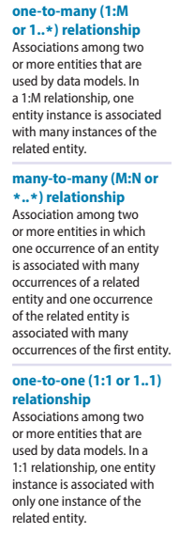
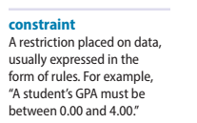
2-3 Data Model Basic Building Blocks
Entity: anything about which data are to be collected and stored
Attribute: a characteristic of an entity
Relationship: describes an association among entities
One-to-many (1:M) relationship
Many-to-many (M:N or M:M) relationship
One-to-one (1:1) relationship
Constraint: a restriction placed on the data

Slide 9

2-4 Business Rules
Descriptions of policies, procedures, or principles within a specific organization
Apply to any organization that stores and uses data to generate information
Description of operations to create/enforce actions within an organization’s environment
Must be in writing and kept up to date
Must be easy to understand and widely disseminated
Describe characteristics of data as viewed by the company

Slide 10
2-4a Discovering Business Rules
Sources of business rules:
Company managers
Policy makers
Department managers
Written documentation
Procedures
Standards
Operations manuals
Direct interviews with end users

Slide 11
2-4a Discovering Business Rules (cont’d.)
Standardize company’s view of data
Communications tool between users and designers
Allow designer to understand the nature, role, and scope of data
Allow designer to understand business processes
Allow designer to develop appropriate relationship participation rules and constraints

Slide 12
2-4b Translating Business Rules into Data Model Components
Nouns translate into entities
Verbs translate into relationships among entities
Relationships are bidirectional
Two questions to identify the relationship type:
How many instances of B are related to one instance of A?
How many instances of A are related to one instance of B?

Slide 13
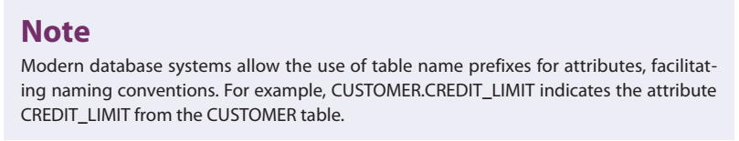
2-4c Naming Conventions
Naming occurs during translation of business rules to data model components
Names should make the object unique and distinguishable from other objects
Names should also be descriptive of objects in the environment and be familiar to users
Proper naming:
Facilitates communication between parties
Promotes self-documentation

Slide 14
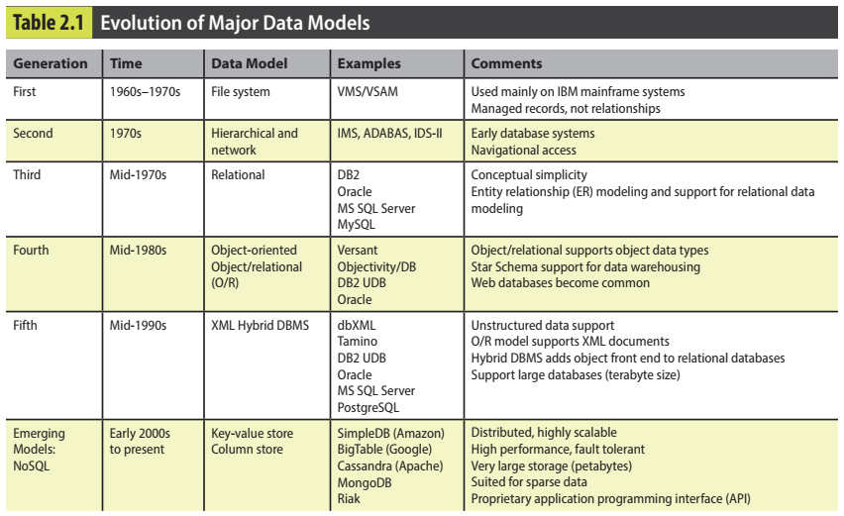
2-5 The Evolution of Data Models

Slide 15
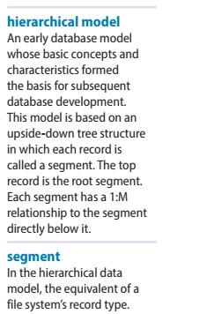
2-5a Hierarchical and Network Models
The hierarchical model
Developed in the 1960s to manage large amounts of data for manufacturing projects
Basic logical structure is represented by an upside-down “tree”
Structure contains levels or segments

Slide 16
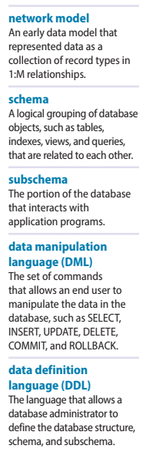
2-5a Hierarchical and Network Models (cont’d.)
Network model
Created to represent complex data relationships more effectively than the hierarchical model
Improves database performance
Imposes a database standard
Resembles hierarchical model
Record may have more than one parent

Slide 17
2-5a Hierarchical and Network Models (cont’d.)
Collection of records in 1:M relationships
Set composed of two record types:
Owner
Member
Network model concepts still used today:
Schema
Conceptual organization of entire database as viewed by the database administrator
Subschema
Database portion “seen” by the application programs

Slide 18
2-5a Hierarchical and Network Models (cont’d.)
Data management language (DML)
Defines the environment in which data can be managed
Data definition language (DDL)
Enables the administrator to define the schema components

Slide 19
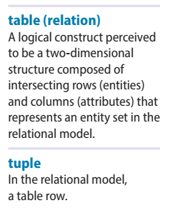
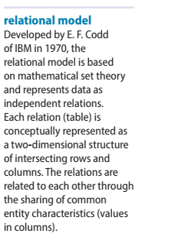
2-5b The Relational Model
Developed by E.F. Codd (IBM) in 1970
Table (relations)
Matrix consisting of row/column intersections
Each row in a relation is called a tuple
Relational models were considered impractical in 1970
Model was conceptually simple at expense of computer overhead

Slide 20
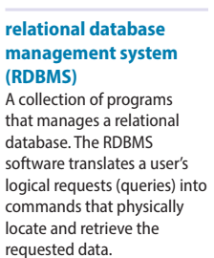
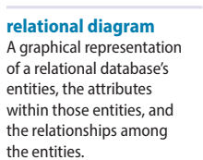
2-5b The Relational Model (cont’d.)
Relational data management system (RDBMS)
Performs same functions provided by hierarchical model
Hides complexity from the user
Relational diagram
Representation of entities, attributes, and relationships
Relational table stores collection of related entities

Slide 21
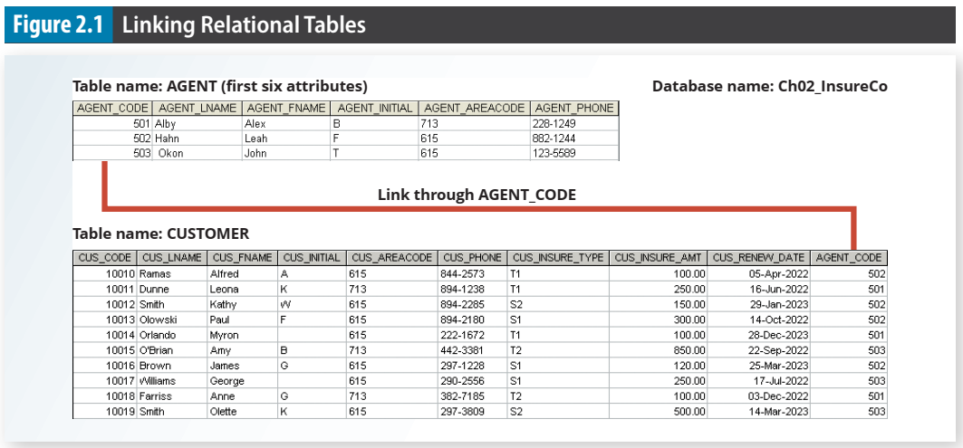

Slide 22
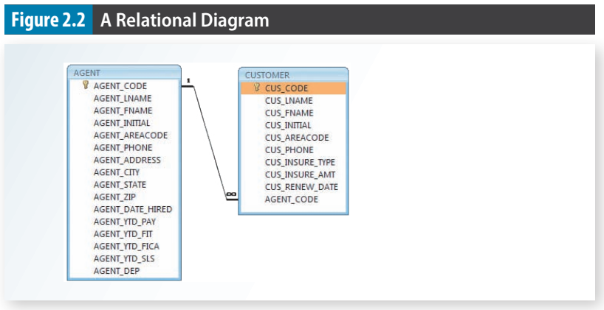

Slide 23
2-5b The Relational Model (cont’d.)
SQL-based relational database application involves three parts:
End-user interface
Allows end user to interact with the data
Set of tables stored in the database
Each table is independent from another
Rows in different tables are related based on common values in common attributes
SQL “engine”
Executes all queries

Slide 24
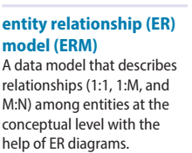
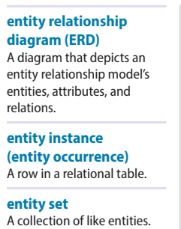
2-5c The Entity Relationship Model
Widely accepted standard for data modeling
Introduced by Chen in 1976
Graphical representation of entities and their relationships in a database structure
Entity relationship diagram (ERD)
Uses graphic representations to model database components
Entity is mapped to a relational table

Slide 25
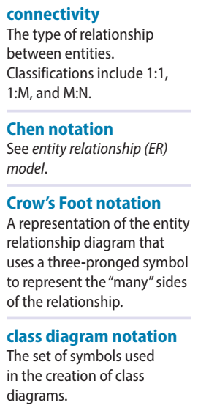
2-5c The Entity Relationship Model (cont’d.)
Entity instance (or occurrence) is row in table
Entity set is collection of like entities
Connectivity labels types of relationships
Relationships are expressed using Chen notation
Relationships are represented by a diamond
Relationship name is written inside the diamond
Crow’s Foot notation used as design standard in this book

Slide 26
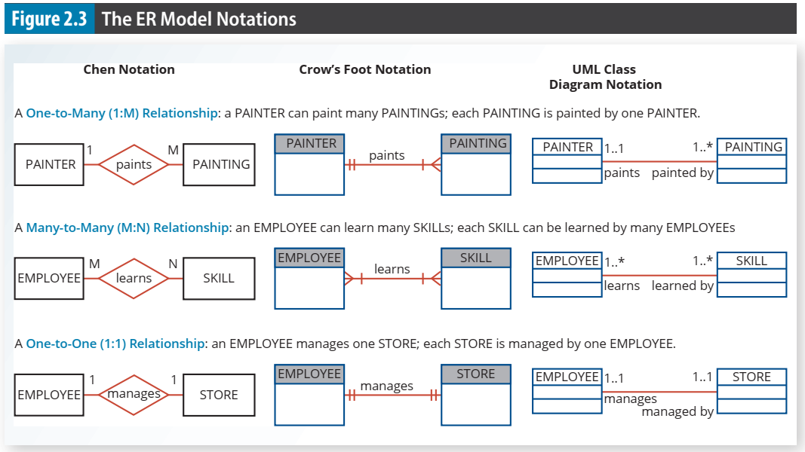

Slide 27
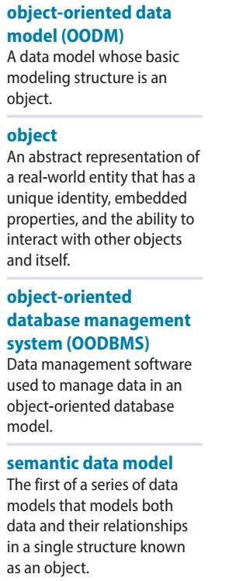
2-5d The Object-Oriented (OO) Model
Data and relationships are contained in a single structure known as an object
OODM (object-oriented data model) is the basis for OODBMS
Semantic data model
An object:
Contains operations
Are self-contained: a basic building-block for autonomous structures
Is an abstraction of a real-world entity

Slide 28
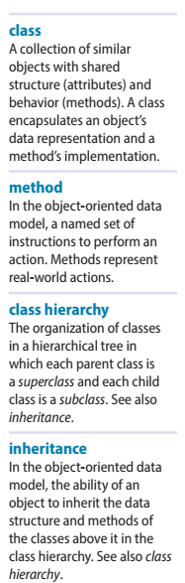
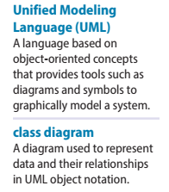
2-5d The Object-Oriented (OO) Model (cont’d.)
Attributes describe the properties of an object
Objects that share similar characteristics are grouped in classes
Classes are organized in a class hierarchy
Inheritance: object inherits methods and attributes of parent class
UML based on OO concepts that describe diagrams and symbols
Used to graphically model a system

Slide 29
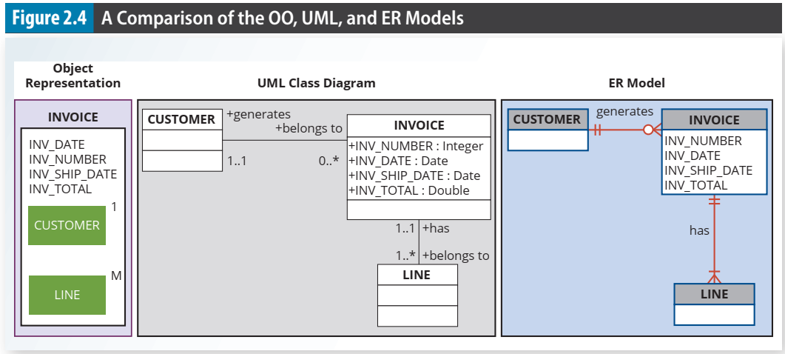

Slide 30
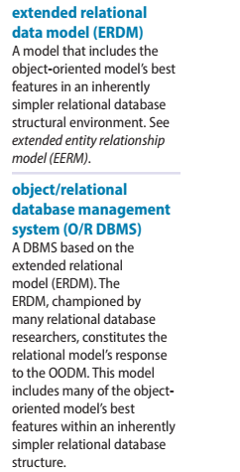
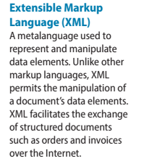
2-5e Object/Relational and XML
Extended relational data model (ERDM)
Semantic data model developed in response to increasing complexity of applications
Includes many of OO model’s best features
Often described as an object/relational database management system (O/RDBMS)
Primarily geared to business applications

Slide 31
Object/Relational and XML (cont’d.)
The Internet revolution created the potential to exchange critical business information
In this environment, Extensible Markup Language (XML) emerged as the de facto standard
Current databases support XML
XML: the standard protocol for data exchange among systems and Internet services

Slide 32
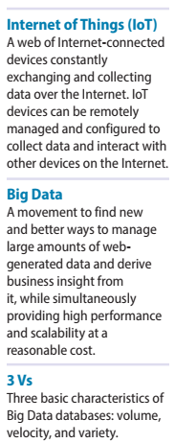
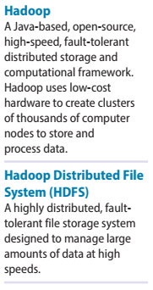
2-5f Emerging Data Models: Big Data and NoSQL
Big Data
Find new and better ways to manage large amounts of Web-generated data and derive business insight from it
Simultaneously provides high performance and scalability at a reasonable cost
Relational approach does not always match the needs of organizations with Big Data challenges

Slide 33
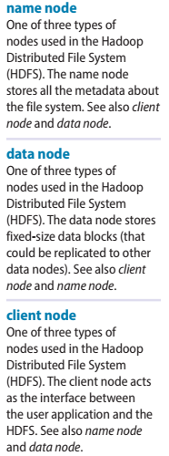
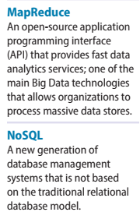
2-5f Emerging Data Models: Big Data and NoSQL (cont’d.)
NoSQL databases
Not based on the relational model, hence the name NoSQL
Supports distributed database architectures
Provides high scalability, high availability, and fault tolerance
Supports very large amounts of sparse data
Geared toward performance rather than transaction consistency

Slide 34
Emerging Data Models: Big Data and NoSQL (cont’d.)
Key-value data model
Two data elements: key and value
Every key has a corresponding value or set of values
Sparse data
Number of attributes is very large
Number of actual data instances is low
Eventual consistency
Updates will propagate through system; eventually all data copies will be consistent

Slide 35
2-5g Data Models: A Summary
Common characteristics:
Conceptual simplicity with semantic completeness
Represent the real world as closely as possible
Real-world transformations must comply with consistency and integrity characteristics
Each new data model capitalized on the shortcomings of previous models
Some models better suited for some tasks

Slide 36
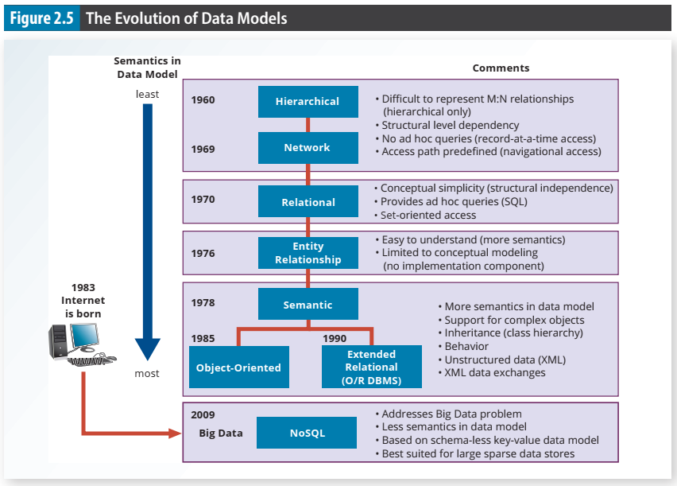

Slide 37
2-6 Degrees of Data Abstraction
Database designer starts with abstracted view, then adds details
ANSI Standards Planning and Requirements Committee (SPARC)
Defined a framework for data modeling based on degrees of data abstraction (1970s):
External
Conceptual
Internal

Slide 38
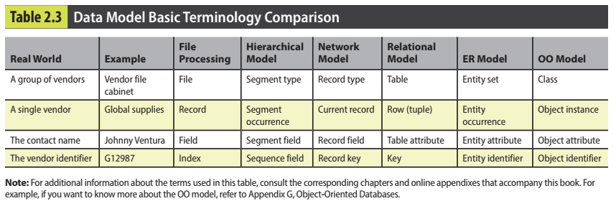

Slide 39
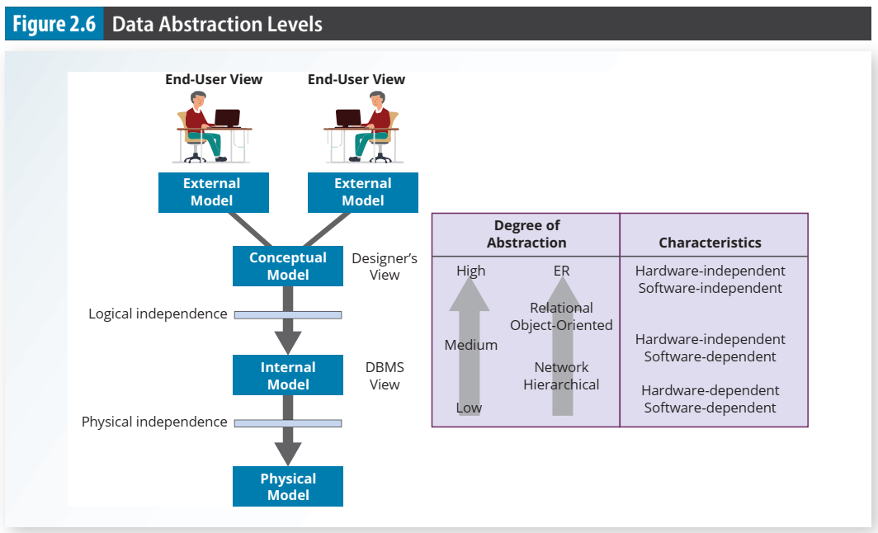

Slide 40
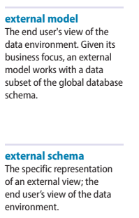
2-6a The External Model
End users’ view of the data environment
ER diagrams represent external views
External schema: specific representation of an external view
Entities
Relationships
Processes
Constraints

Slide 41
2-6a The External Model (cont’d.)
Easy to identify specific data required to support each business unit’s operations
Facilitates designer’s job by providing feedback about the model’s adequacy
Ensures security constraints in database design
Simplifies application program development

Slide 42
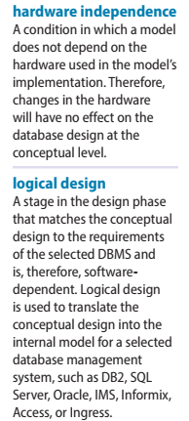
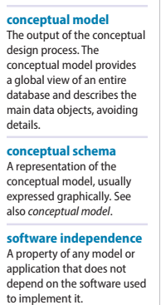
2-6b The Conceptual Model
Represents global view of the entire database
All external views integrated into single global view: conceptual schema
ER model most widely used
ERD graphically represents the conceptual schema

Slide 43
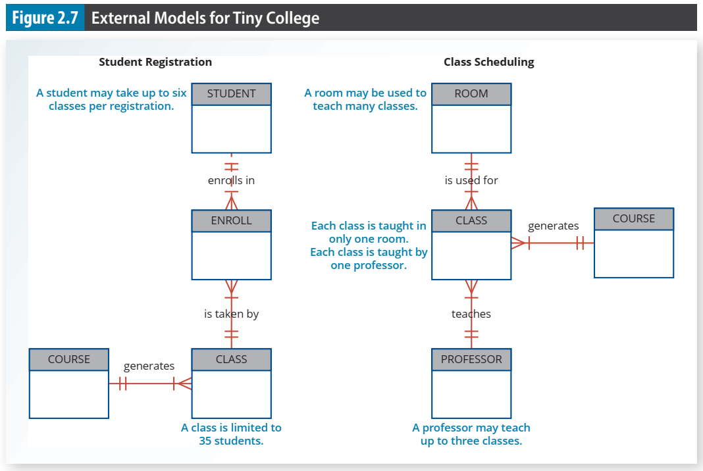

Slide 44
2-6b The Conceptual Model (cont’d.)
Provides a relatively easily understood macro level view of data environment
Independent of both software and hardware
Does not depend on the DBMS software used to implement the model
Does not depend on the hardware used in the implementation of the model
Changes in hardware or software do not affect database design at the conceptual level

Slide 45
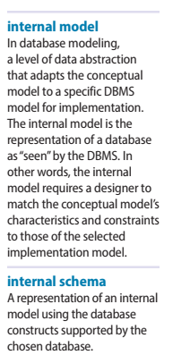
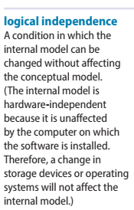
2-6c The Internal Model
Representation of the database as “seen” by the DBMS
Maps the conceptual model to the DBMS
Internal schema depicts a specific representation of an internal model
Depends on specific database software
Change in DBMS software requires internal model be changed
Logical independence: change internal model without affecting conceptual model

Slide 46
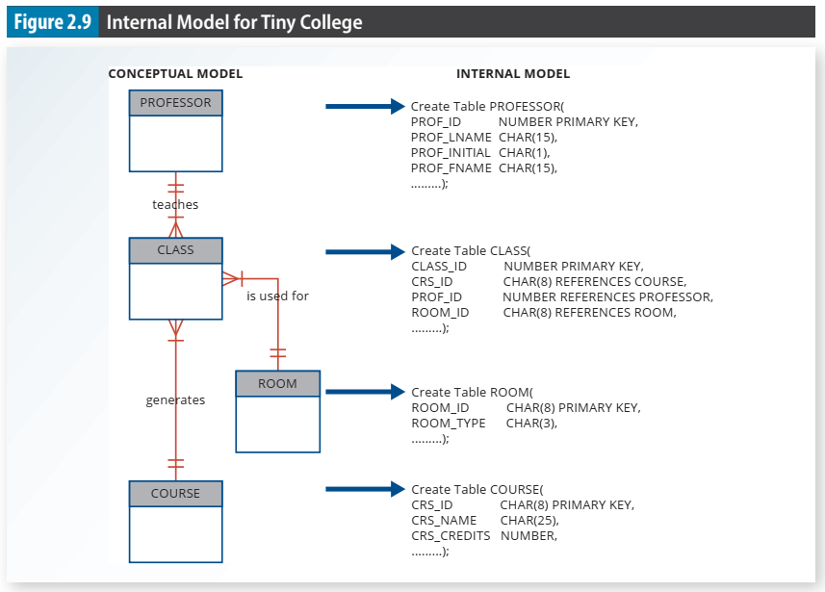

Slide 47
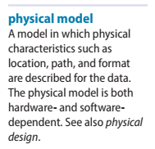
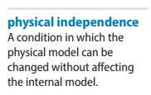
2-6d The Physical Model
Operates at lowest level of abstraction
Describes the way data are saved on storage media such as disks or tapes
Requires the definition of physical storage and data access methods
Relational model aimed at logical level
Does not require physical-level details
Physical independence: changes in physical model do not affect internal model

Slide 48
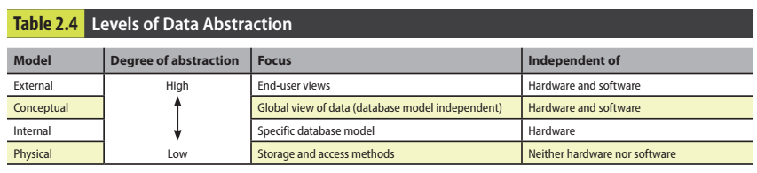

Slide 49
Summary
A data model is an abstraction of a complex real-world data environment
Basic data modeling components:
Entities
Attributes
Relationships
Constraints
Business rules identify and define basic modeling components

Slide 50
Summary (cont’d.)
Hierarchical model
Set of one-to-many (1:M) relationships between a parent and its children segments
Network data model
Uses sets to represent 1:M relationships between record types
Relational model
Current database implementation standard
ER model is a tool for data modeling
Complements relational model

Slide 51
Summary (cont’d.)
Object-oriented data model: object is basic modeling structure
Relational model adopted object-oriented extensions: extended relational data model (ERDM)
OO data models depicted using UML
Data-modeling requirements are a function of different data views and abstraction levels
Three abstraction levels: external, conceptual, and internal

Slide 52
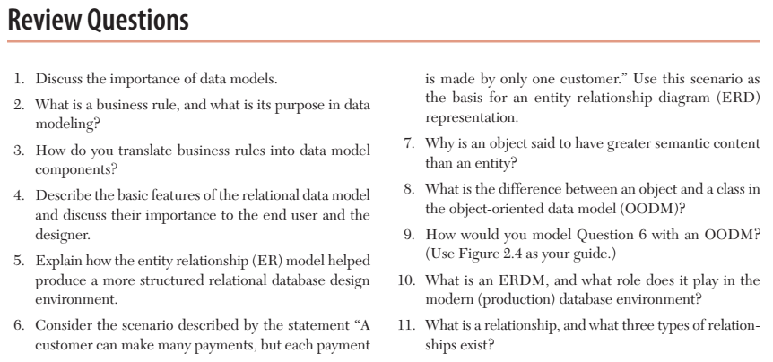

Slide 53
